Slide 1
MODULE 6
Derived Data Types
&
Intro. To Basic OOP
By: Adekola Olubukola PhD

Slide 2
Derived Types:
Data type indicates the type of data a variable can store and also the type of operations that can be performed on it. The primitive types are the built in that come with the language (e.g. int, float) while the derived types are the ones defined by the users to solve complex problems. The following are derived/user-defined data types:
Derived Types Examples
1) Array (Grouping data of same type under a name)
2) string (Series of Characters)
3) struct (Defining records)
4) class (component of OOP design)
5) enum (defining integral constants)

Slide 3
Array (In Summary):
An array is an identifier or a variable name that refers to a collection of data items using the same name. This set of data items using the same single name must be of the same data type.
Creating an array in C++ can take the following forms:
datatype arrayName[size of array];
e.g. int points[4]; //integer array named points allocated space for 4 elements
Note that the size of the array or the number of elements must be known and set before you can start using the array.
Array points still needs to be assigned element after the memory declaration/definition above.
Array indexing, i.e. assessing the element usually starts from zero(0) to n-1 in C++.
Elements can be assigned in the following major ways:

Slide 4
Direct assignment or using a loop statement:
int points[4]; // space allocation at declaration
points[0] = 5;
points[1] = 3; or
points[2] = 7;
points[3] = 2;
for(int i = 0; i<4; ++i)
{
cout<<" \nEnter Element:" ;
cin>> points[i] ; //keyed in by user
}
(b) When elements are known before hand:
If all elements are known before hand, declaration, initialization and allocation can be done as follows with each element separated by comma:
int points[4] = {5, 3, 7, 2};
or
int points[] = {5, 3, 7, 2}; /* with the blank in the square bracket, the compiler automatically detects the size of the array or the quantity of elements since they are already listed. */

Slide 5
Assessing Elements of an array:
The First element can be referenced as: cout<<points[0];
The Second element can be referenced as: cout<<points[1];
The Last element in a 4 element- array can be referenced as:
cout<<points[3];
Elements here can also be accessed using a loop as follows:
for(int i = 0; i<4; ++i)
{
cout<<points[i] ;
}

Slide 6
String Type: (In Summary)
In C, a string is created simply as array of characters terminated with the null character '\0'. The latest ANSI/ISO standard for C++ specified that C++ must now also have a class string that allows the programmer to treat strings like a basic data type without needing to worry about implementation details. The class string in C++ provides more versatile string representation than the C strings in C language.
The class string is defined in the following library:
#include <string>
= operator can be used to assign a value to a string variable
+ operator can be used to concatenate two strings.
Consider the following, suppose s1, s2, and s3 are objects of type string.

Slide 7
//Demonstrating standard class string
#include <string>
using namespace std;
void main()
{
string s3; //s3 is initialized to empty string here
string s1(“Hallelujah"); /* class string has a constructor that
initializes a string object to the value in quote*/
string s2= “Amen";
s3 = s1 + " " + s2 + "!";
cout << s3 << endl;
}
OUTPUT
Hallelujah Amen!

Slide 8
I/O with the Class string:
The extraction operator >> and cin work the same for string objects as for other data but the extraction operator ignores initial whitespace and stops reading when it encounters more whitespace:
string s1;
cin >> s1;
Using the extraction operator >> and cin, you can only read in words; you cannot read in a line or other string that contains a blank.
If you want your program to read an entire line of input into a variable of type string(containing whitespace), you can use the function getline.
string line;
cout << "Enter a line of input:\n";
getline(cin, line);
cout << line<<endl;

Slide 9
Struct: (In Summary)
Before we introduce classes, we will first present structures (also known as structs). A structure is a kind of simplified class. Structures may be a stepping-stone to understanding classes. A structure can be thought of as an object without any member functions. Thus, the definition of a class should be a data type definition that describes two things: (1) what kinds of values the variables can hold and (2) what the member functions are. Simply put, when you extend structures, you are already defining classes.
While array is used to defined data of the same type, structure(struct) is used to define data of different types. Sometimes it is useful to have a collection of values of different types and to treat the collection as a single item (possibly because they are related in a way).
E.g. 1: consider a bank certificate of deposit(CD), which is a bank account that does not allow withdrawals for a specified number of months.

Slide 10
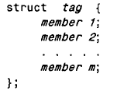
Struct: (In Summary)
Usually, a CD account has 3 pieces of data associated with it:
the account balance ( of type double)
the interest rate for the account (of type double)
the term i.e. the number of months until maturity (of type int)
Structure definition format is as follows:
Such that: struct is a required keyword; tag is a name that identifies structures of this type (having this composition); member I , member 2, . . . , member m are individual member declarations.
The tag can be any legal identifier (but not
a keyword). Members could be of any types, int, float, array or even another struct. Here, structure definitions are seen as structure declarations.

Slide 11
Struct: Example 1
struct CDAccount
{
double balance;
double interest_rate;
int term; //number of months until maturity
};
Like a globally defined constant declaration, a structure definition is usually placed outside of any function definition. The structure type is then available to all the code that follows the structure definition. The structure type can be used like the predefined types int, char etc.
We can declare 2 variables of type CDAccount as follows:
CDAccount childAccount, adultAccount;

Slide 12
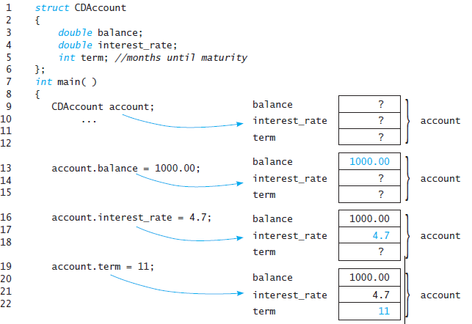
Code Illustration:

Slide 13
Manipulating structure members(variables):
The members of a structure are usually processed individually, as separate entities. Therefore, we must be able to access the individual structure members. A structure member can be accessed by:
variable.member
variable is the name of a structure-type variable.
member refers to the name of a member within the structure.
The dot (.) operator is inserted between variable and member. The dot (.) is a member of the highest precedence group, and its associativity is left to right.
E.g.
account.balance = 1000.00;
account.balance = account.balance + interest;

Slide 14
struct: Example 2
struct account {
int acct_no;
char acct_type;
string name;
float balance;
};
account oldcustomer, newcustomer; //variable of type account
oldcustomer = {1001, ’C’, “Daniel Adekola”, 10000.50}; //setting of initial values
//referencing the present account balance for oldcustomer structure type variable
cout<<“The present balance is: ”<< oldcustomer.balance;
//updating account balance for oldcustomer structure type variable
float deposit;
cin>>deposit;
oldcustomer.balance = oldcustomer.balance + deposit ;

Slide 15
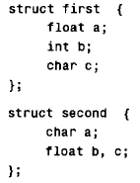
Reusing member names:
Each structure is a self-contained entity with respect to member definitions. Thus, the same member name can be used in different structures to represent different data. i.e. the scope of a member name is confined to the particular structure within which it is defined. Consider the following example:
In this example variable/ member a is of type float in first struct but char in second. This is allowed, since the scope of each set of member definitions is confined to its respective structure.

Slide 16


Further Example:
Consider the following 2 struct definitions within the same program. If we declare also different structure variables for the structure definition:
1
2
3
4
5
6
7
8
9
10
11
12
13
14
15
16
growFast.quantity = 200;
apples.quantity = 300;
NOTE: if apples and oranges are structure variables of the type CropYield as defined
, then the following is allowed:
apples = oranges;
This assignment statement is equivalent to:
apples.quantity = oranges.quantity;
apples.size = oranges.size;
FertilizerStock growFast;
CropYield apples;

Slide 17
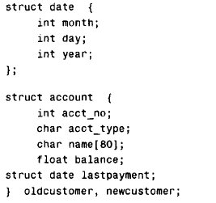
Note:
A structure definition must end with a semicolon. Also, you are allowed to list structure variable names between that final brace and that final semicolon.
struct CropYield
{
int quantity;
double size;
} apples, oranges;
A structure variable may be defined as a member of another structure. In such situations, the declaration of the embedded structure must appear before the declaration of the outer structure.
The second structure (account) now contains another structure (date) as one of its members

Slide 18
Basis of Object oriented Programming Concepts
In Object Oriented Programming (OOP) paradigm, the basic building block are objects and are implemented in classes. Software solution coming out of OOP are simply interacting objects. The essential features of object oriented concepts that distinguished it from procedural programming are basically encapsulation, polymorphism and inheritance. All these are implemented in classes or via classes so to speak. Then what is a class?
A class defines the form of an object. It is a set of plans where we specify how an object is built. The primary unit of encapsulation is the class. A class is the general template we use to define and create specific instances or objects. A Class encapsulates or binds attributes/data and member functions (codes) into objects.

Slide 19
Basis of Object oriented Programming Concepts
Then what is encapsulation?
Encapsulation is a programming mechanism that binds together code/functions and the data it manipulates. In a simple term, the act of creating a class (or making a class properly so that it will behave well like predefined data types) is what we call encapsulation! So when code(function) and data are linked together in this fashion, an object is created. Therefore, an object is the device that supports encapsulation.
An object is an instance of a class while a class defines an object. So when you instantiate an class, it means you create an object. It means that a class contains both code(function) and data (bound together) to birth objects. The code and data are called members of that class. The code is the function member and the data is called the data member.

Slide 20
OOP Benefits and Idiosyncrasies:
It is important to know is that programming in an object oriented language is more than just learning new syntax or new language. It’s a new way of thinking. In procedural languages, we think in terms of data structures and algorithms but in Object Oriented Programming (OOP) we think in terms of objects and their relationships. Users typically do not think in terms of data or process; instead, they see their business as a collection of logical units that contain both—so communicating in terms of objects improves the interaction between the user and the analyst or developer.
OO concept helps in developing high quality software at a much easier and faster pace. Object-oriented programs are easier to understand, correct and modify. Languages like C++, Java etc. are good tools in learning OOP concepts.

Slide 21
Class (Constituent component of OOP design)
DEFINING CLASSES: Basis of Object oriented Concepts
A class is a derived (user-defined) data type just as a structure is. The conventional difference (but not technical) is that a structure (struct) is used to define values of the structure type by defining only member variables (being public) and having no member functions while a class defines both member variables(data) as well as member functions to work with them. Simply put, to obtain a class, all you need do is to add some member functions to the already defined variables in a structure. We can say that a class is an extension of struct having functions. The is true for a normal or conventional usage so as to speak the same language across software communities. But a C++ structure can do technically what a class can do. However, a class should be defined in the right way to be as well behaved as the predefined data types.

Slide 22
Class (Constituent component of OOP design)
DEFINING CLASSES: Basis of Object oriented Concepts
While encapsulation is the binding together of code/functions and data, abstraction is simply information hiding. Abstraction is obtainable both in structured programming concept and in OOP. In abstraction/information hiding, codes are written in a way that they could be used as black boxes, that is, the programmer who uses the code/function need not know any details about how the function is implemented. It means a programmer only needs to know how to use them possibly by knowing the function declaration and the accompanying comment that explains how to use the function. The use of private member variables and private member functions in the definition of an abstract data type is another way to implement information hiding. Benefits are ease of modification, reusability and security.

Slide 23
Class (Constituent component of OOP design)
STRUCT VS CLASS: (Implementation Definitions)
struct eagle {
float weight; //only defines data/variable
int age;
} ; //end of structure definition
fly(); // function defined separately in another part of the entire program
hunt(); // function is seen as separate from data; standing alone
class eagle {
float weight;
int age;
fly();
hunt();
} //end of class definition
Here, both data/variables and codes/ functions are bound together in a single unit called class. Note: to make them well-behaved, they must be related. i.e programmer should not include unrelated function in this code

Slide 24
Class (Constituent component of OOP design)
STRUCT VS CLASS: (Implementation Definitions)
In the procedural Pattern where struct is used in that manner:
data do not have owner and there is difficulty in maintaining data integrity. For example, many functions are using shared data.
there is insufficient support for abstraction.
illegal utilizations can only be handled at runtime
In the OOP Pattern where class is used, we enjoy the following:
functions here are not needlessly global
the compiler directly knows which functions own the data, since they are bound together. Illegal utilizations easily prevented.
there is experience of better abstraction

Slide 25
DEFINING CLASSES: Basis of Object oriented Concepts
Class = state (data members defined e.g. weight) + behavior(function defined e.g. hunt() as seen in the earlier illustration)
Object: An object has state, exhibits some well-defined behaviours (commonly called functions/methods) and has a unique identity (Booch, 1995). Unique identity means one object is different from the other.
A state of an object is the value of its variable/data member per time.
E.g. weight = 25; // meaning the eagle has state 25 kg which could be changed.
C++ format example: The access modifier is declared once for all members of same modification.
Access Specifier class ClassName
{
private: //Declaration of private members
//members listed here
public: //Declaration of public members
//members listed here
}; // semicolon ends the class definition

Slide 26
DEFINING CLASSES: Basis of Object oriented Concepts
The diagram below is the Unified Modeling Language(UML) Class Diagram used to model class design. A class is drawn by using 3 part-rectangles with the class’s name at the top,
attributes/variables in the middle, and functions at the bottom. The only mandatory part of a class diagram is the name compartment used to show relationship between different classes.
//Class Definition- C++ example:
class Rectangle
{
public:
double area(); //operations /functions on rectangle defined here
double perimeter();
private:
double length; // data to be used by the operations/functions
double breadth;
};
Note: The first law of OOP is that data/variables must be hidden(make it private); to enhance security. You can read/write to data by creating read/write functions.
Rectangle
- length : int - height : int
+ area() : int + perimeter () : int

Slide 27
DEFINING CLASSES: Class Diagrams
Class members visibility are majorly public (+), protected (#), or private (-). You can attach any of the visibility to variables or functions depending on what you intend to hide:
A public attribute/function is one can be seen from any where.
A protected attribute is hidden from all other classes except its immediate subclasses.
A private attribute is one that is hidden from all other classes.
The default visibility for an attribute is usually private.
Functions are better defined public (because you expect them to be used by others outside its class definition) except for helper function(i.e. the one that is only to be used within the class)
There are three kinds of operations that a class can contain: constructor, query, and update.
Specifier | Description
Private | Private members (variables or functions) in a class can be seen, used, assigned or changed only by other members of the same class. Private members are neither accessible by the object nor inherited by the derived class.
Protected | Protected members in a class can be seen, used, assigned or changed by other members of the class. They can be inherited by the derived/subclass. Protected members are also not accessible by the object.
Public | Public members may be seen, used, assigned, or changed by all class members and also accessible by objects. Any part of the program that has access to the class object can access public members (variables or functions) via the object.

Slide 28
DEFINING CLASSES: Rectangle Class Example
Rectangle Class Implementation Example 1:
In this example, we will define both our variables and functions under the keyword public specifier only and ignore details on that for now. It means that all members can be seen within and outside the class definition. There is no restriction.
//Program to demonstrate a simple example of Rectangle class.
#include <iostream>
using namespace std;
class Rectangle
{
public:
double area( ); //member function declaration/prototype
double perimeter(); // this function is to be defined in the later portion
double length; //member variable declaration
double breadth;
}; // meaning the class definition has ended here

Slide 29
Rectangle Class Implementation Example 1 contd.:
// function definition goes here
double Rectangle::area()// this function needs to be linked to its class using :: the scope resolution operator
{
return length*breadth; // what the function should do is implemented here
};
double Rectangle:: perimeter()
{
return 2*(length+breadth);
};
// the main program where object of Rectangle class is created and used
Int main()
{
Rectangle small, big; //two objects instantiated
cout << “\nEnter the length of the small rectangle: ";
cin >> small.length; // variable length is public so can be accessed from main function via its object (small).
cout << “\nEnter the breadth of the small rectangle: ";
cin >> small.breadth;

Slide 30
Rectangle Class Implementation Example 1:
cout << “ \nThe area of the small rectangle is: “;
cout << small.area();
cout << “ \nThe perimeter of the small rectangle is: “;
cout << small. perimeter ();
//accessing variables and functions for the 2nd object
cout << “\nEnter the length of the small rectangle: ";
cin >> big.length;
cout << “\nEnter the breadth of the small rectangle: ";
cin >> big.breadth;
cout << “ \nThe area of the big rectangle is: “;
cout << big.area();
cout << “ \nThe perimeter of the big rectangle is: “;
cout << big. perimeter();
return 0;
}// end of function main
The operator :: is called the scope resolution operator. It serves a purpose similar to the dot operator. The scope resolution operator :: is used with a class name; indicating that a particular function is a member of the class attached to it.
The class name that precedes the scope resolution operator is often called a type qualifier, because it specializes (“qualifies”) the function name to one particular type.
double Rectangle:: perimeter(){…}
Whereas the dot (.) operator is used with objects:
small.length; // accessing the class public variable
small.area(); //accessing function

Slide 31
Rectangle Class Implementation Example 2:
This example takes us closer to the ideal. Remember the law of OOP says data should be (hidden) private. We will introduce declaring variables private and creating set(mutator) and get(accessor) functions to use them. This is to prevent inadvertent modification of the variables. The following example insists that you can only access variables through the functions in the class.
//Program to demonstrate involving accessor and mutator functions.
#include <iostream>
using namespace std;
class Rectangle
{
public: //all functions and variables here can been seen outside of this class
double getLength(); // accessor function commonly preceded with the word get
void setLength( double l); //mutator function fondly tagged with the word set
//you also need to define setBreadth() and getBreath() for the 2nd variable
double area( );
double perimeter();
Private: // all functions and variables listed from this point are hidden
double length;
double breadth;
}; // meaning the class definition has ended here

Slide 32
Rectangle Class Implementation Example 2 contd.:
// accessor function definition for variable length
double Rectangle::getLength()
{
return length;
}
// mutator function for variable length
void Rectangle::setLength(double l)
{
length = l;
}
//…set and get are similarly defined for breath …we skip this to save time…(do it yourself)
double Rectangle::area()// this function needs to be linked to its class using :: the scope resolution operator
{
return length*breadth; // what the function should do is implemented here
};
double Rectangle:: perimeter()
{
return 2*(length+breadth);
};

Slide 33
Rectangle Class Implementation Example 2:
// the main program where object of Rectangle class is created and used
Int main()
{
Rectangle small;
cout << “\nEnter the length of the small rectangle: ";
cin >> small.length; // you CANNOT access a private member variable directly – this is now wrong
//read in the value and send to setLength function
int len, bre;
cin >>len;
// you can now access length via its set function
cin >> small.setLength(len);
cin >>bre;
// you can now access breadth via its set function
cin >> small.setBreadth(bre);
cout << “ \nThe area of the small rectangle is: “;
cout << small.area();
cout << “ \nThe perimeter of the small rectangle is: “;
cout << small. perimeter ();
cout << “ \nThe length of the small rectangle is: “<<getLength();
cout << “ \nThe Breadth of the small rectangle is: “<<getBreadth();
return 0;
}// end of function main

Slide 34
Rectangle Class Example 2: Note
Classes should be defined in such a way that they can behave well like the predefined types. You can build a library of your own class type definitions and them as if they were predefined types. For example, you could place each class definition in a separate file and copy it or (link them) into any program that uses the type. If you change the implementation of a class (for example, by changing some details in the definition of a member function in order to make function calls run faster), then you should not need to change any of the other parts of your programs. In order to realize this ideal, get and set functions are introduced. So we redefine Example 1 to get use Example 2 where variables are declared private and set and get functions are made to access them. The variables are no longer accessed directly. It is now illegal to write:
cin >> small.length; or small.length = 5.5; // compiler flags an error for this
You now need to go through its get or set functions:
small.setLength(5.5);

Slide 35
Rectangle Class Example 2: Accessor and Mutator Functions
Member functions that allow you to find out the values of the private
member variables of a class are called accessor (getter or get) functions. The accessor functions need not literally return the values of each member variable, but they must return something equivalent to those values. The names of accessor functions commonly (but not required) include the word get.
Member functions that allow you to change the values of the private
member variables of a class are called mutator (setter or set) functions. The names of mutator functions normally include the word set.
It is important to always include accessor and mutator functions with
each class definition so that you can change the data stored in an object.
Remember, the principles of keeping variables/data private and restricting access to public functions is the basic idea of encapsulation. This implies that variables length and breadth are better defined private for security and data integrity.

Slide 36
Introducing Constructor functions
A constructor is a function that helps in creating our objects. In the earlier examples, there were no explicit definition of any constructors. It means the compiler makes use of a default constructor when none is defined. Such is called implicit constructor. You don’t need to bother if they exist but they are. All you do is just instantiate your objects, e.g.:
Rectangle small, big; //object created via implicit constructor
You can also define your own constructors, it means this default constructor will no longer be automatically available. But if you want the default constructor to still be available then you have to re-define it explicitly. You can have more than one constructors in a program. This is another example of function overloading in a feature called polymorphism.
Consider the following updated code Example 3:

Slide 37
Rectangle Class Example 3: Constructors
//Program to demonstrate involving constructor functions.
#include <iostream>
using namespace std;
class Rectangle
{
public: //all functions and variables here can been seen outside of this class
Rectangle(); // prototype for default constructor which is to be explicitly defined
Rectangle( double l, double b); // user-defined constructor prototype
double getLength(); // accessor function commonly preceded with the word get
void setLength( double l); //mutator function fondly tagged with the word set
//you also need to define setBreadth() and getBreath() for the 2nd variable
double area( );
double perimeter();
Private: // all functions and variables listed from this point are hidden
double length;
double breadth;
}; // meaning the class definition has ended here

Slide 38
Rectangle Class Implementation Example 2 contd.:
// explicit definition of a default constructor function, no code in the function body
double Rectangle:: Rectangle() // it sets variables/ objects to their default initial values
{
}
// user-defined or parametized constructor function to set values to length and breadth
void Rectangle:: Rectangle(double l, double b)
{
length = l; // sets the variable length the value passed to it via parameter l from outside
breadth = b;
}
// other codes continue as usual
Int main()
{
//instantiating objects using user-defined constructor
Rectangle small(4.5, 20.0), big(22.5, 11.4); //two objects with initial values
//instantiating objects using default constructor allowed because its constructor is re-defined
Rectangle medium; // medium variables e.g. length are set to default also, 0.0 for double value
…..//continuation…..

Slide 39
Note about a constructor function:
In C++, a constructor function are defined as public and must have the same name as the class.
A constructor is called automatically when an object of the class is declared.
A constructor does not have a return type and does not even use the word “void” otherwise the compiler would think it is a regular function
A user-defined constructor function can be used to set initial values to object variables similar to how you will use a set function.
If you defined a user-defined constructor, you don’t have access to the default any longer except you explicitly define the default as well.

Slide 40
Destructor function:
A destructor function is a member function having same name as its class preceded by ~(tilde) sign and which is used to destroy the objects that have been created by a constructor. It is invoked when an object is out of scope . The class destructor doesn't return a value and doesn't have parameters defined: //sample definition
~Rectangle() {}
//illustration
class Rectangle
{
private:
// members
public:
Rectangle() //constructor (same name as class)
{ }
~Rectangle() //destructor (same name with tilde)
{ }
};

Slide 41
SUMMARY: Major Distinguishing Features of OOP:
There are 3 major features in object-oriented programming that makes them different from non-OOP languages namely:
(a) encapsulation,
(b) inheritance and
(c) polymorphism.
Encapsulation and Information Hiding:
Encapsulation in Object-oriented methodology is simply the combining of function and data into a single entity. Information hiding was first promoted in structured systems development. The principle of information hiding suggests that only the information required to use a software module be published to the user of the module (abstraction). Combining encapsulation with the information hiding principle suggests that the information hiding principle be applied to objects instead of merely applying it to functions . Classes encapsulate or bind attributes and member functions into objects. Objects communicate but do not have each other’s implementation details (that are hidden within each object itself). The principle of keeping variables/data private and restricting access to public functions is the basic idea of encapsulation.

Slide 42
SUMMARY: Major Distinguishing Features of OOP:
Polymorphism
Polymorphism means that the same message can be interpreted differently by different classes of objects. For example, if we sent the message “Draw yourself ” to a square object, a circle object, and a triangle object, the results would be very different, even though the message is the same. Polymorphism is either static or dynamic binding. Static is demonstrated in function overloading. Dynamic or late binding is a technique that delays identifying the type of object until run-time -demonstrated in function overriding.
In a traditional programming language, instead of sending the message “Draw yourself ” to the different types of graphical objects, you would have to write decision logic by using a case statement or a set of “if ” statements to determine what kind of graphical object you wanted to draw, and you would have to name each draw function differently(e.g. drawSquare, drawCircle).

Slide 43
Polymorphism: Function Example
Overloading as a type of polymorphism: Occurs when several functions have same name with:
different type of parameters.
different number of parameters.
same number of parameters but of different type
//Implementation example of function overload
int findMax(int a, int b)
{
if (a>b) return a;
else return b;
}
int findMax(int a, int b, int c)
{
int biggest = a;
if (b> biggest) biggest = b;
if (c > biggest) biggest = c;
return biggest;
}

Slide 44
SUMMARY: Major Distinguishing Features of OOP:
Inheritance
Inheritance entails making a new class object from an existing class either by customizing or adding new unique characteristics. Therefore, stabilized components are easily reused. E.g. an object of class “convertible” can be made from general class “automobile”.
Common sets of attributes and functions can be organized into superclasses. Typically, classes are arranged in a hierarchy whereby the superclasses, or general classes, are at the top, and the subclasses, or specific classes, are at the bottom.
Subclasses inherit the attributes and functions from the superclass above them. Instead of repeating the attributes and functions in the employee and customer classes separately, the attributes and methods that are common to both are placed in the person class and inherited by those classes below it.
Some classes do not produce instances, because they are used merely as templates for others that are more specific classes (especially those classes located high up in a hierarchy). They are called abstract classes.

Slide 45
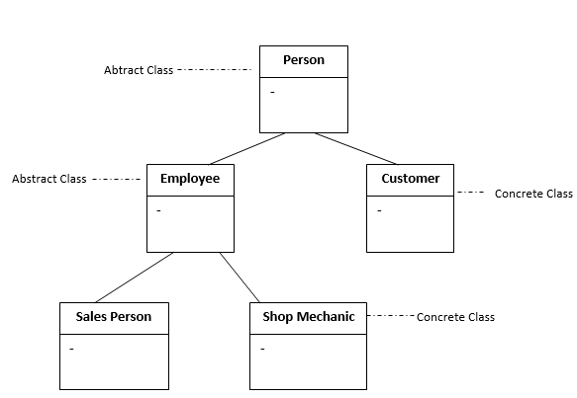
SUMMARY: Major Distinguishing Features of OOP:
Inheritance Class Hierarchy
In the following, Person is a superclass to the classes Employee and Customer
Figure 6.4: Showing Person as a superclass to Employee and Customer classes.

Slide 46
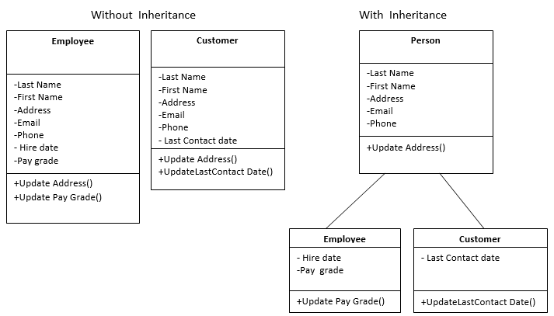
SUMMARY: Major Distinguishing Features of OOP:
Designs with and without Inheritance – Spotting the difference
Figure 6.5: Code repetition difference in no inheritance and with inheritance.

Slide 47
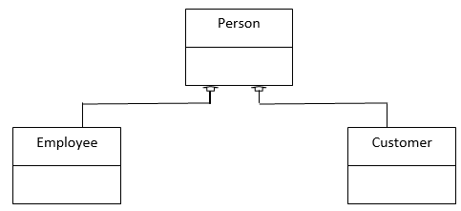
SUMMARY: Major Distinguishing Features of OOP:
Generalization is the term used to denote abstraction of common properties into a base class in UML(unified modeling language). The UML diagram's Generalization association is also known as Inheritance. Going specific into subclasses is called specialization.
Figure 6.6: A summarized view of inheritance:
Person
Specialisation
Generalisation
Employee
Customer
Figure 6.7: A more summarized view of class relationship showing only the name compartment

Slide 48
Tasks:
Briefly explain the idea of class creation in line with making a datatype.
Why do we characteristically make the data/variables members of a class private:?
Define the following terms: (i) Object (ii) Attribute (iii) Behaviour
Define the following terms: (i) Mutator (ii) Accessor (iii) Constructor
Draw the UML class diagram for a named class having two methods in which one is public and the other is void
Using Object Oriented Programming, implement a Class for Calculator. Create 4 functions within the Calculator class to implement addition, multiplication, subtraction and division. Your main program should read in two inputs, and output result for the operations.
The set function could also be used to validate data before assigning it to the data member. Write a set method that validates user’s input for a clock object such that “26:50:12” would be alarmed invalid for hh:mm:ss format (hours can’t be up to 26).
Imagine the various activities at an ATM (Automated Teller Machine) that can aid successful transaction between your Bank and you. Using object oriented concept, develop a class having operations that would do the following: (i) checking your balance (ii) making withdrawal and (iii) making deposit.

